Slide 1
Object Oriented Programming(Java) Lecture 17

Slide 2
Content
JApplet class in Applet
Example of EventHandling in JApplet
Painting in Applet
Example of Painting in Applet

Slide 3
JApplet class in Applet :
As we prefer Swing to AWT. Now we can use JApplet that can have all the controls of swing. The JApplet class extends the Applet class.

Slide 4
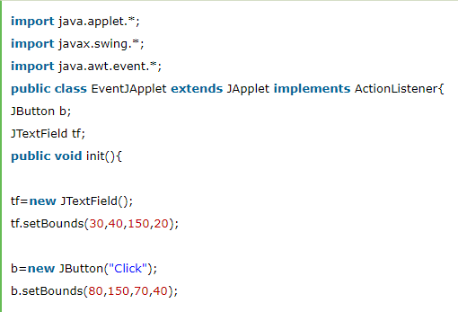
Example of EventHandling in JApplet :

Slide 5
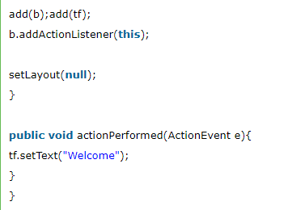
Example of EventHandling in JApplet :

Slide 6
Painting in Applet
We can perform painting operation in applet by the mouseDragged() method of MouseMotionListener.

Slide 7
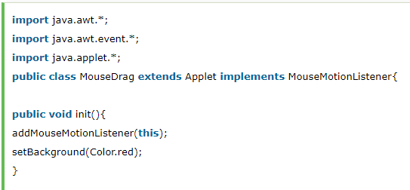
Example of Painting in Applet :

Slide 8
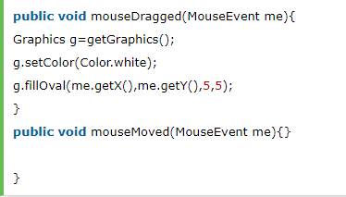
Example of Painting in Applet :

Slide 9
References :
https://www.javatpoint.com/JApplet
https://www.javatpoint.com/Painting-in-applet

Slide 10
Thanks

